Slide 1

FT sensors: usage with Vector and Simulink
04 Oct – 19 Jan

Slide 2
Scenario: Static identification
Identification of PMSM motor parameters in static and dynamic conditions
Control
Board
PMSM
Motor
Output sensor
CAN Msg
Reader
Input Variables
(e.g. 3-phase voltage)
Output Variables
(e.g. Torque,
Rotor position)
Notes:
To merge with 3

Slide 3
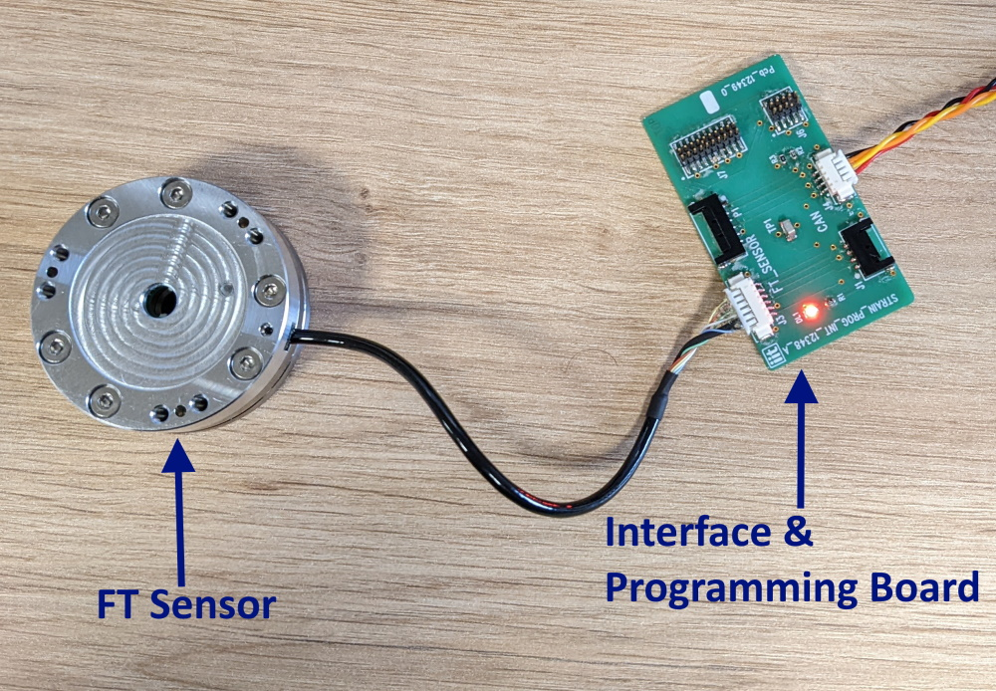
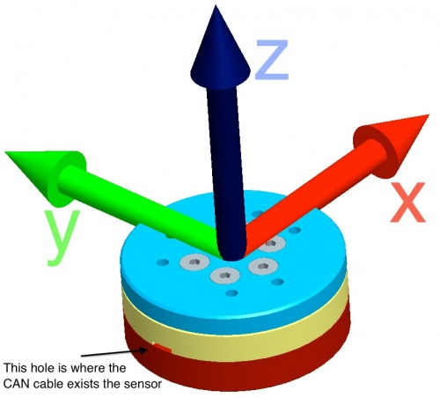
FT45 Sensor
6 Degrees of Freedom Sensor
Based on a Wheatstone bridge
12 semiconductor strain gauges arranged in a 6 half-bridges configuration

Slide 4
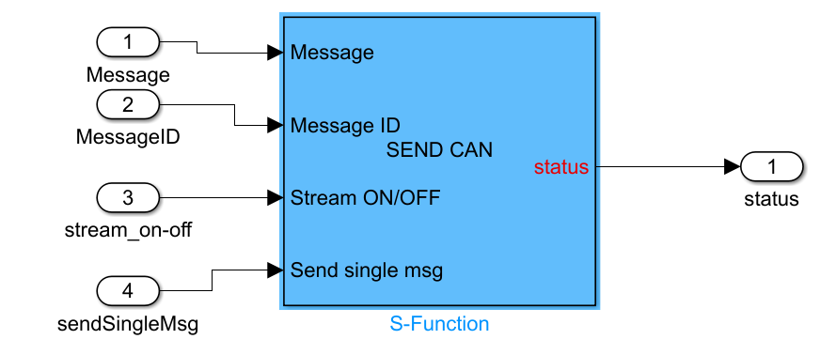
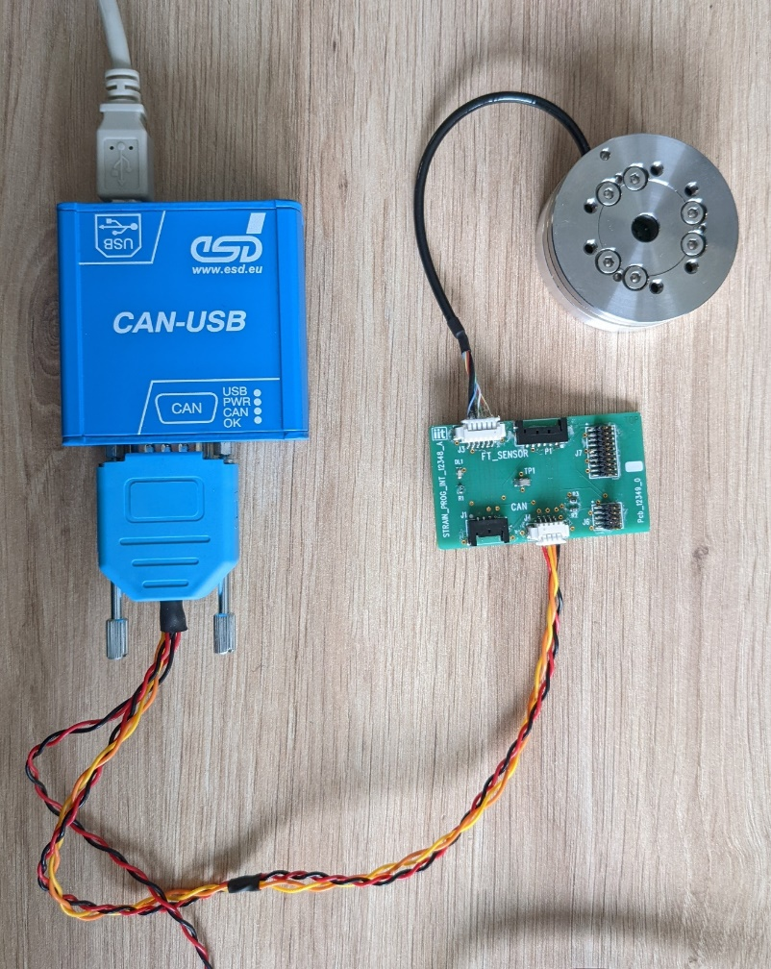
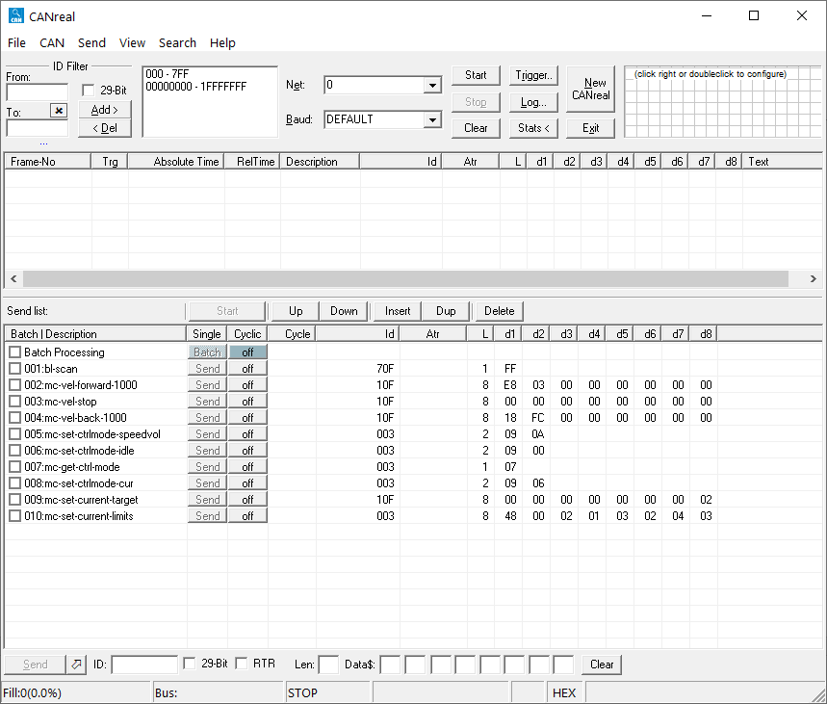
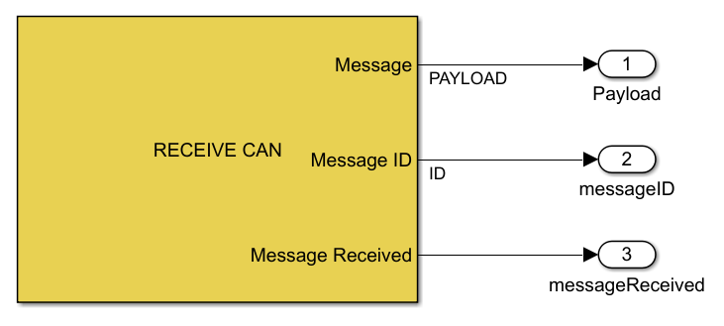
Legacy CAN communication method
ESD CAN-USB box for CAN communication
CANReal for monitoring
Reliance on custom-made C language blocks for messaging

Slide 5
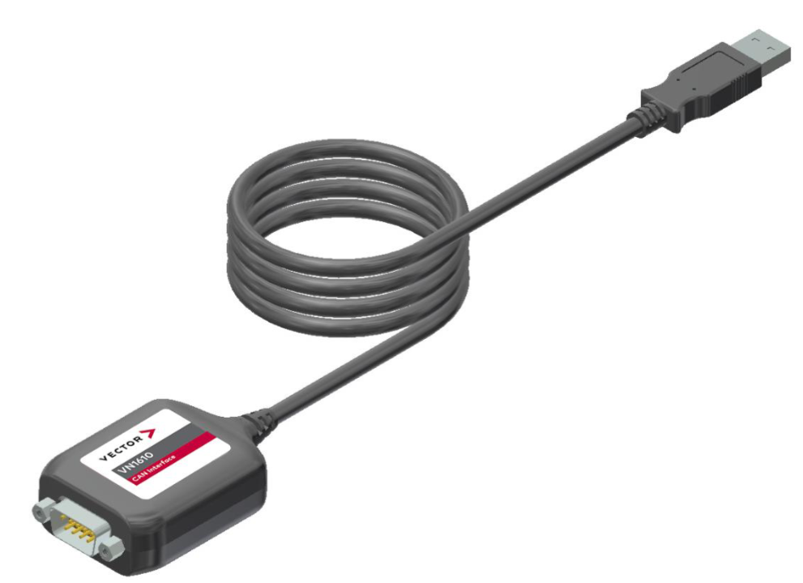
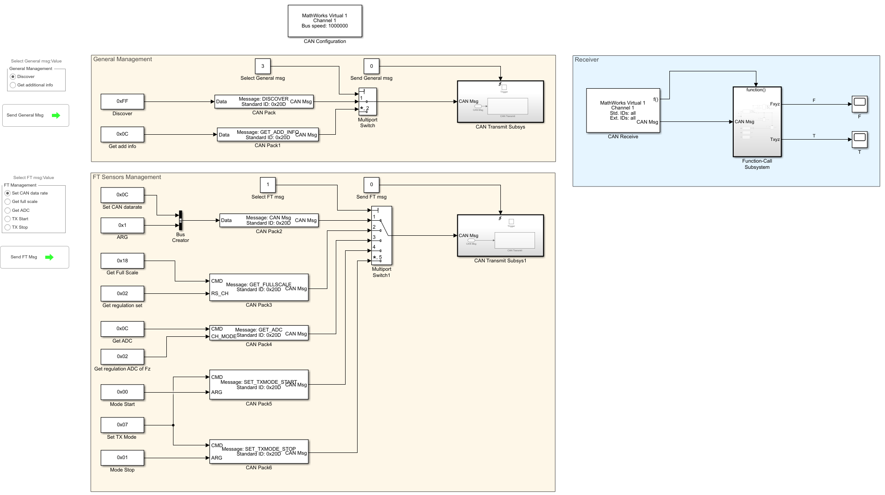
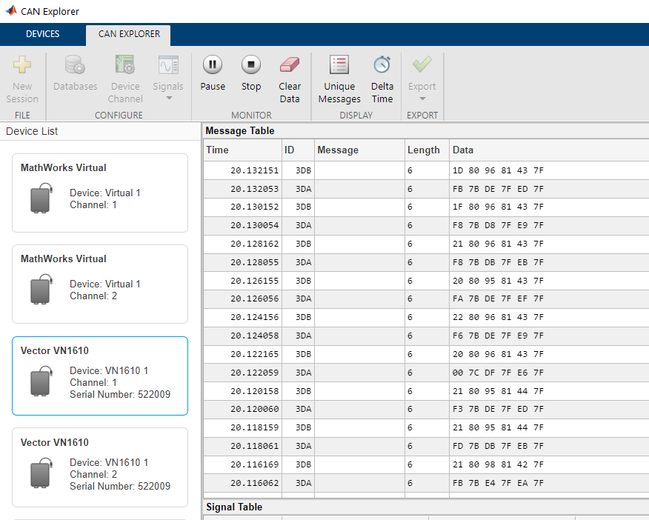
Proposed CAN messaging with Vector and Simulink
Vector transceiver with built-in Simulink support
Use of native Simulink blocks and functions to send and receive messages

Slide 6
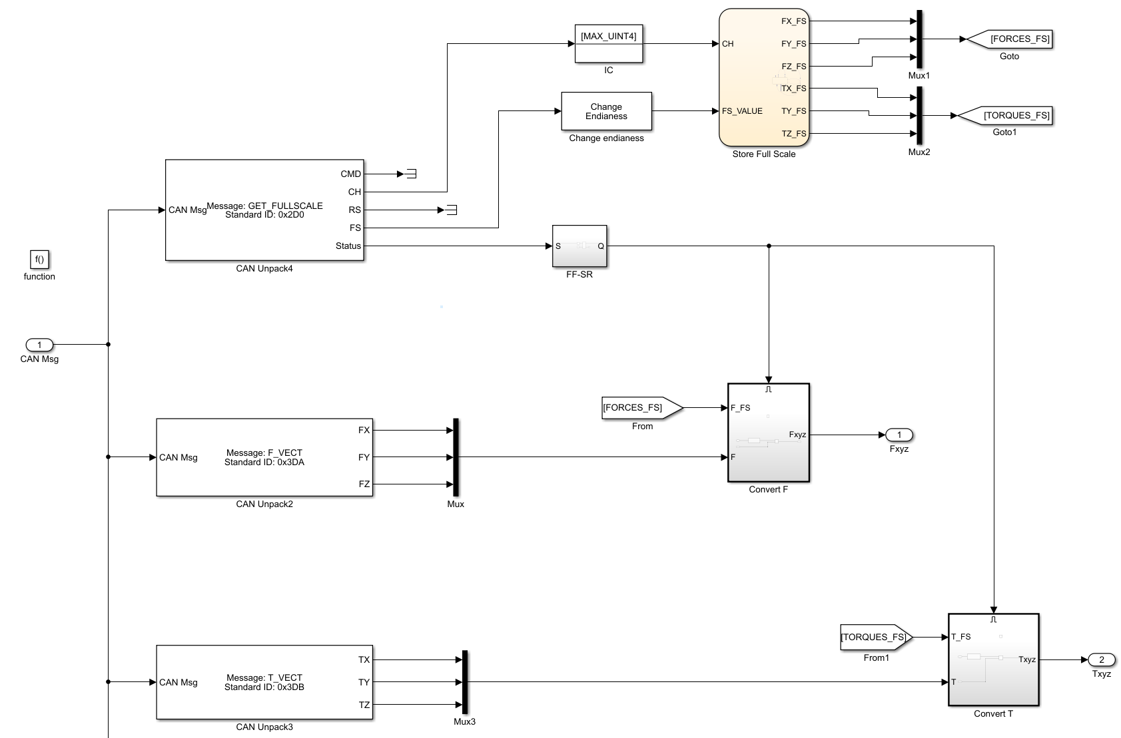
Proposed CAN messaging with Vector and Simulink
Message reception and unpacking easily implemented
State machine to store full scale values
General Management
➡ DISCOVER
➡ GET_ADDITIONAL_INFO
FT Sensor Specific
➡ GET_FULL_SCALE
➡ GET_ADC
➡ SET_CAN_DATARATE
➡ SET_TX_MODE (Start / Stop)
⬅ FORCE_VECTOR
⬅ TORQUE_VECTOR
⬅ UNCALIB_FORCE_VECTOR
⬅ UNCALIB_TORQUE_VECTOR

Slide 7
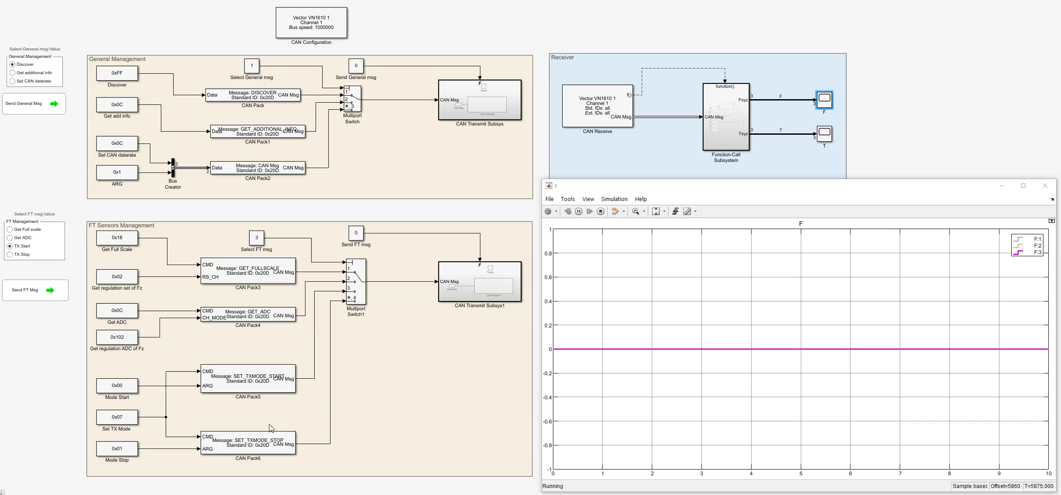
Demo video with preliminary acquisitions

Slide 8
Relevant Links
FT-sensors-simulink Repository : Contains the presented Simulink model
vector-devices Repository : Contains instructions on how to setup the device
Implement a Simulink driver to read the FT45 sensor - Github Issue : Issue documenting the journey to implement the driver and the preliminary tests

